Slide 1
Chainmaille 101

Slide 2
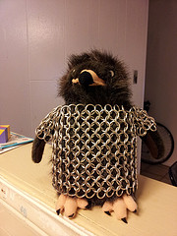
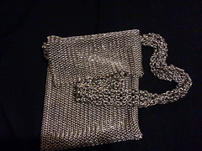
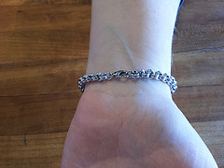

Slide 3
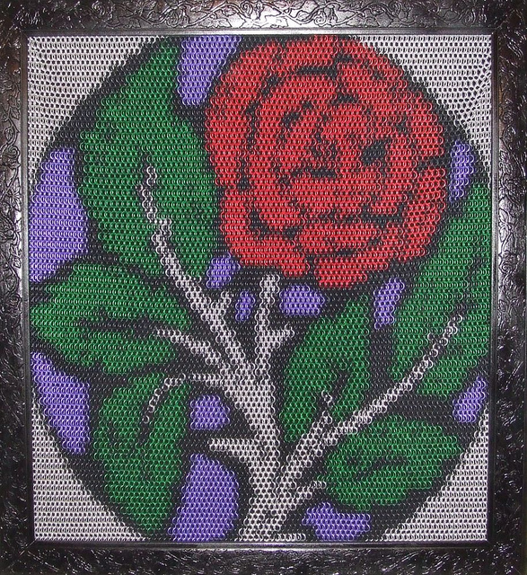
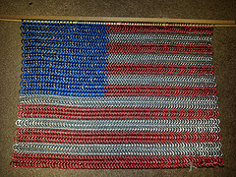
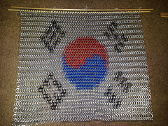
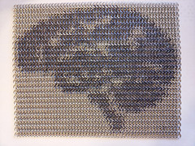
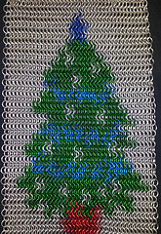

Slide 4
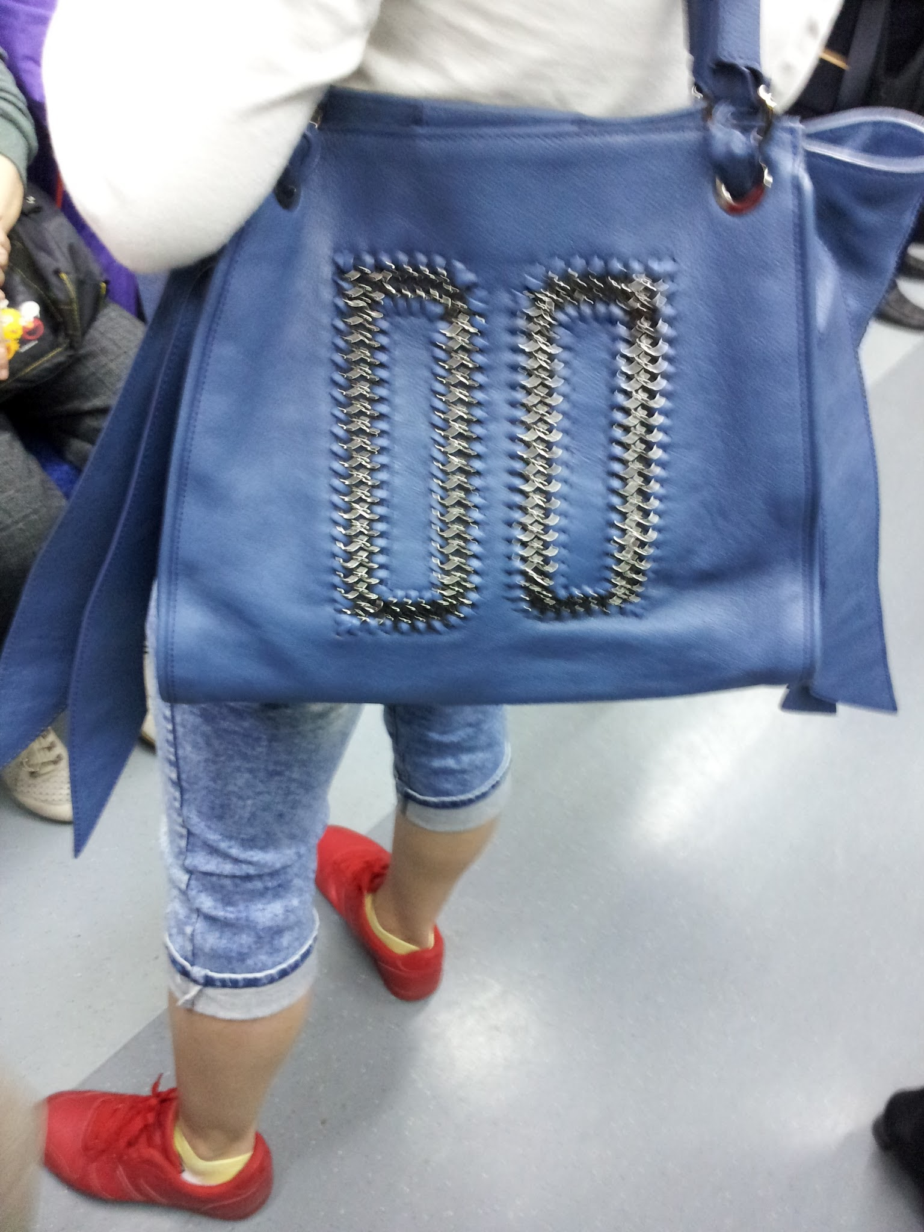

Slide 5
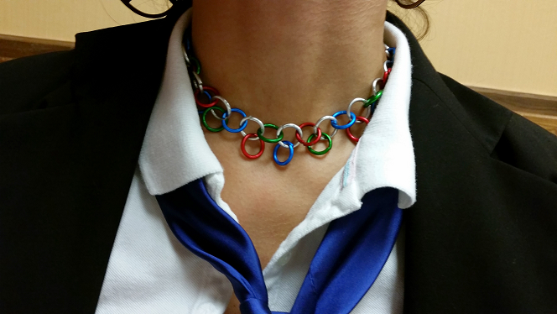
Previous examples!

Slide 6
Step 1: Rings… which material?

Slide 7
Step 1: Rings… which material?

Slide 8
Step 1: Rings… which material?

Slide 9
Step 1: Rings… which material?

Slide 10
Step 1: Rings… Aluminum!

Slide 11
Step 1: Rings… which size?!?

Slide 12
Step 1: Today’s Rings:
Aluminum 14 gauge 3/8”
(This doesn’t matter, unless it does.)

Slide 13
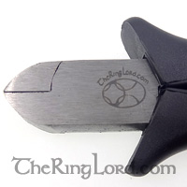
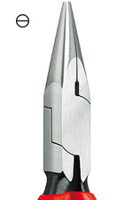
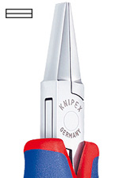
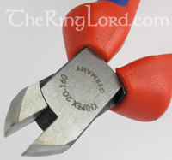
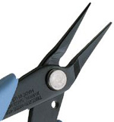
Set 2: Pliars… which ones?

Slide 14
Step 1: Today’s Pliars:
TheRingLord Brand - Toothless
Around $6.50
Length: 5inch 125mm
(This doesn’t matter, unless it does.)

Slide 15
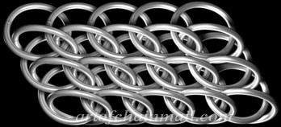
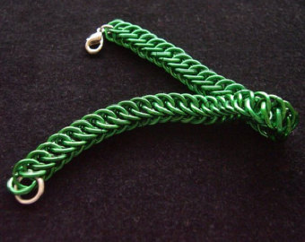
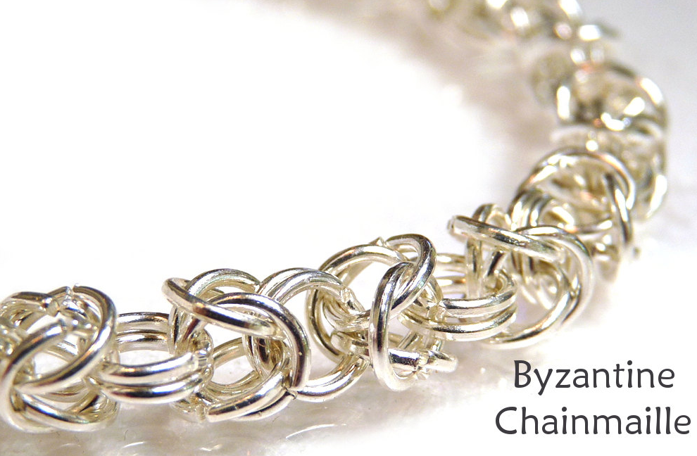
Step 3: Pattern… which one?

Slide 16
Step 1: Today’s Pattern:
European
4-in-1
(Each ring goes through 4 others)

Slide 17
Ok… How? (Adapted from http://www.artofchainmail.com/patterns/european/basic1in4.html)
Place an open link through four closed links.
Close the open link.
Lay the first five links out like this.

Slide 18
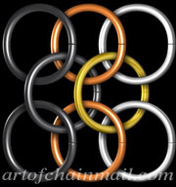
Adding to the Column Edge
Place an open link through 2 closed links.
Place the open link through the 2 column edge links coloured copper in the illustration.
Close the open link.
Repeat this step to make the pattern wider.

Slide 19
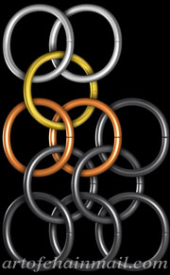
Adding to the Row Edge Start
Place an open link through 2 closed links.
Place the open link through the 2 row edge links coloured copper in the illustration.
Close the open link.
Repeat this step each time you start adding a row.

Slide 20
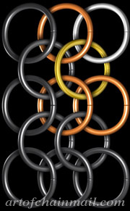
Adding to the Row Edge
Place an open link through a closed link.
Place the open link through the 3 links coloured copper in the illustration.
Close the open link.
Repeat this step to continue a new row, making the pattern longer.

Slide 21
